Slide 1
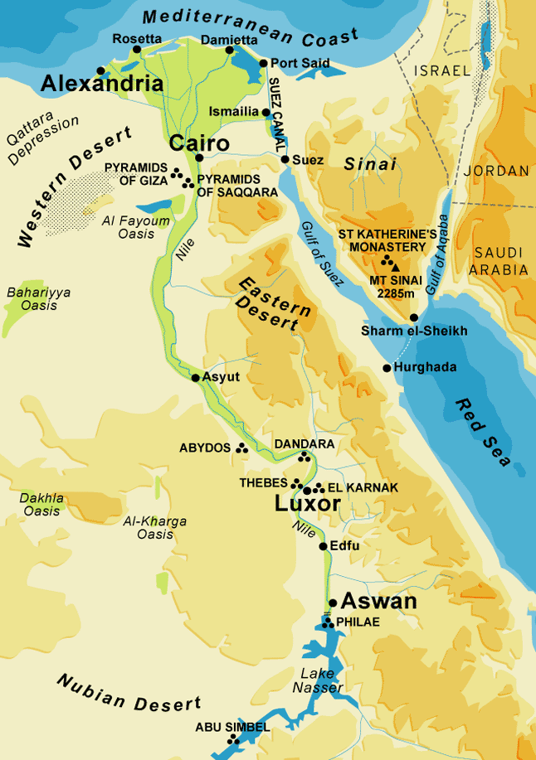
Early Egypt
By 5500 B.C.E. farming communities were established along the Nile River
Divided in to Upper and Lower regions
United in 3100 B.C.E.
Old Kingdom – 2700 – 2200 B.C.E.
Middle Kingdom –2052 – 1786 B.C.E.
New Kingdom – 1575 – 1087 B.C.E.

Slide 2
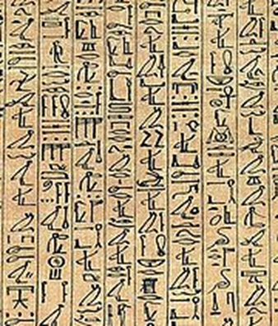
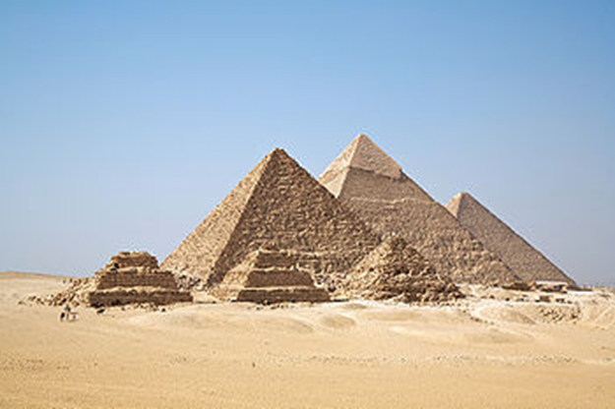
Old Kingdom
2700 – 2150 B.C.E.
Established its capital at Memphis
Creation of hieroglyphics, or writing about 3200 B.C.E.
Great Pyramids of Giza built circa 2560 B.C.E.
Mummification of kings and elites practiced

Slide 3
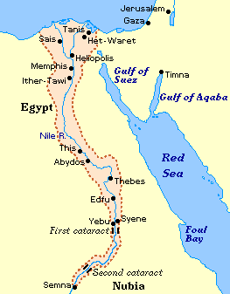
Middle Kingdom
2052 – 1786 B.C.E.
Rulers of Thebes reunite Egypt
Osiris became a central religious god
Expanded control into Nubia and the Sinai
Declined after a series of weak kings and drought

Slide 4
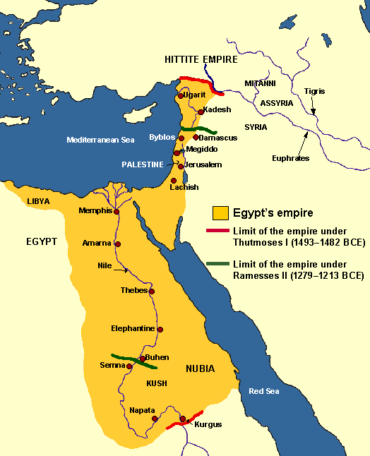
New Kingdom
1575 – 1087 B.C.E.
Known as the “empire period” of Egypt
Most prosperous period of Egypt
Peak of Egyptian power
The title “pharaoh” came into use
Declined due to continued warfare

Slide 5
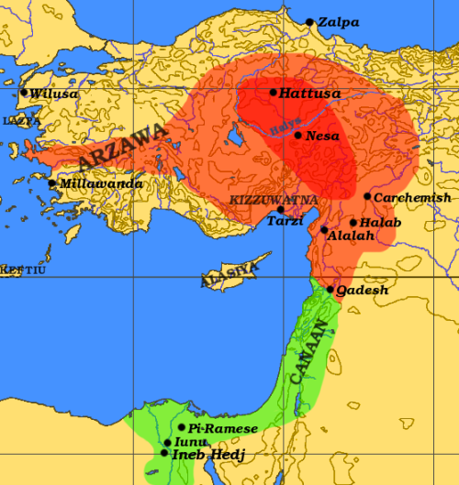
Near East circa 1290 B.C.E.
Hittite Kingdom established around 1500 B.C.E. in central Anatolia
Hittite Empire peaked 1400 – 1200 B.C.E.
Egyptians and Hittites clash in the struggle for dominance in the region in 1274 B.C.E. at the Battle of Kadesh
The battle halted the expansion of both empires

Slide 6
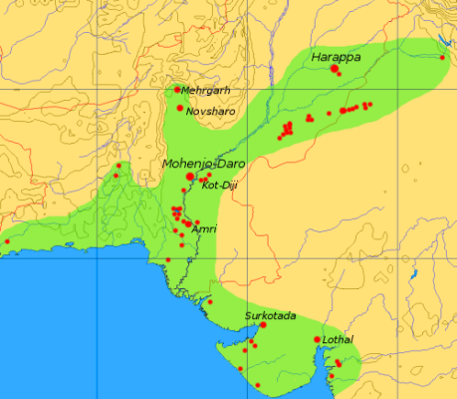
Indus River Valley Civilization
By 2600 B.C.E. communities were widespread in the valley
By 2300 B.C.E. Harappa became a leading urban center
Harappan Culture became widespread by 2100 B.C.E.
Drought led to the decline of the culture by 1900 B.C.E.

Slide 7
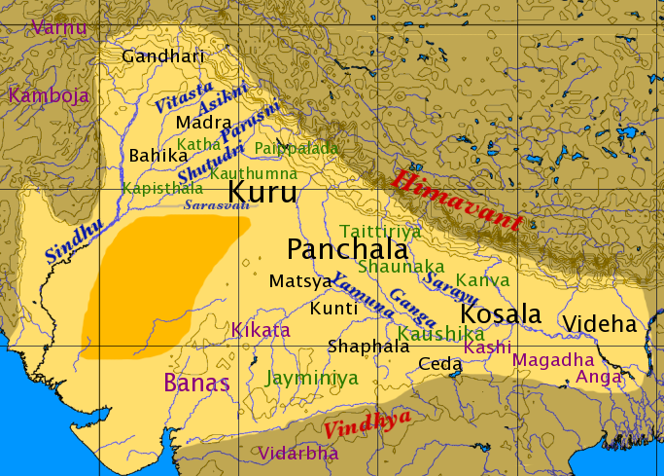
Vedic Aryan Civilization
1500 – 500 B.C.E.
Drought forced nomadic tribes to seek new herding lands
By 1800 B.C.E. the Aryans began to occupy areas of the Indus River Valley
Known as the Vedic Period
Named for the Vedas, the earliest scriptures of Hinduism

Slide 8
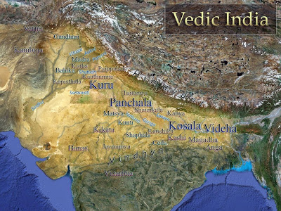
The Rigvedic Age
1700 – 1000 B.C.E.
Around 1700 B.C.E. migrating Aryan nomadic tribes settled in the Indus River Valley
Period filled with internal and external conflicts
New scriptures were added to the Vedas

Slide 9
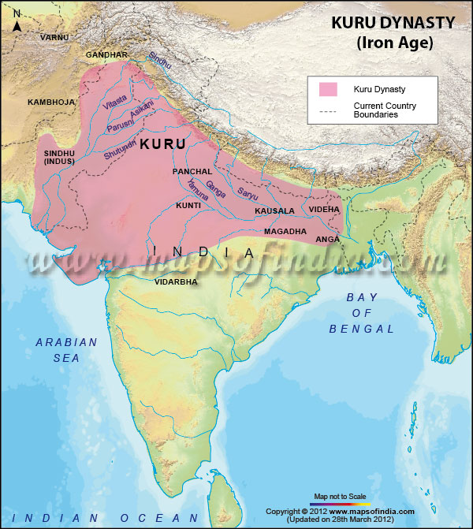
Later Vedic or Brahmanic Age
1000 – 500 B.C.E.
By 1000 B.C.E. many Vedic tribes were turning to farming
Expanded into the Ganges River Valley
New scriptures led to the Varna, or caste, social system
Brahman priest and nobility were the 1st Estate

Slide 10
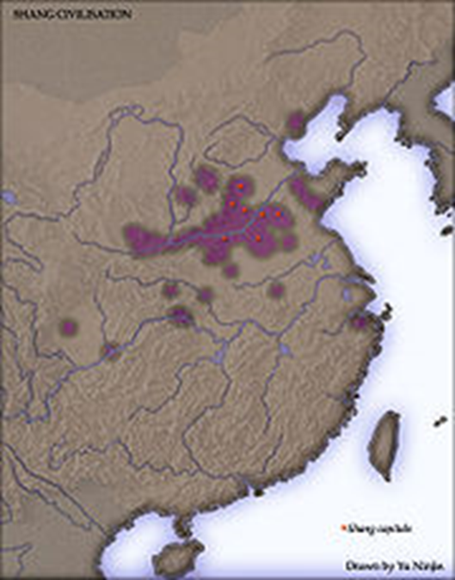
Yellow River Valley
By 2600 B.C.E. communities were widespread in the valley
Referred to as the mother river of China and the cradle of Chinese civilization
Earliest Chinese kingdoms and empires originated in the valley
United under the Xia Dynasty
around 2100 B.C.E.

Slide 11
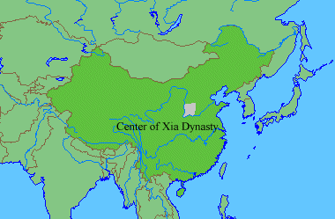
Xia Dynasty
2100 – 1600 B.C.E.
The Xia consolidated their power in north central China
Considered to be the 1st traditional dynasty in modern Chinese history
Declined due to internal and external threats and natural disasters

Slide 12
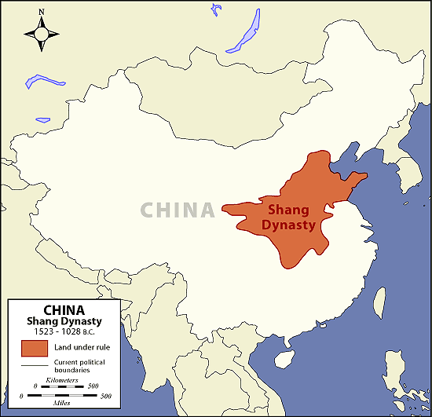
Shang Dynasty
1600 – 1050 B.C.E.
The Shang kingdom rose to power with the decline of the Xia
Brought stability to the region
New technologies included metallurgy, the calendar and writing
Set the standard for future dynasties

Slide 13
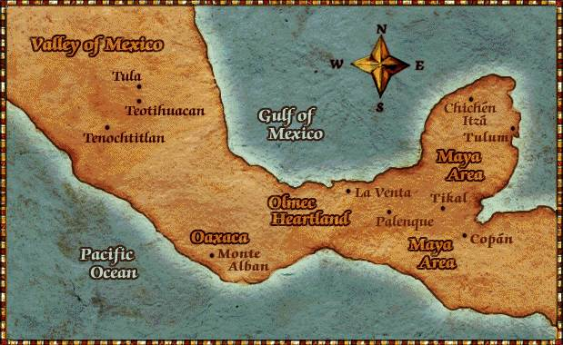
Mesoamerica Civilizations
Settled agriculture became widespread by 8000 B.C.E.
Establishment of cultural centers around 4000 B.C.E.
By 3500 B.C.E. cultivation of maize was widespread
By 2500 B.C.E. pottery was used for storage of food stuffs

Slide 14
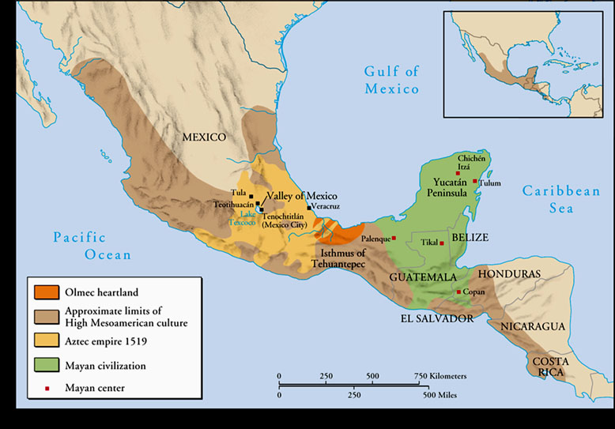
Formative Period
2000 B.C.E. – 150 C.E.
By 2000 B.C.E. tribal communities were established
By 1800 B.C.E. Mayan civilization began to emerge on the Yucatan Peninsula
The Olmec emerged as a leading culture along the Gulf of Mexico around 1400 B.C.E.

Slide 15
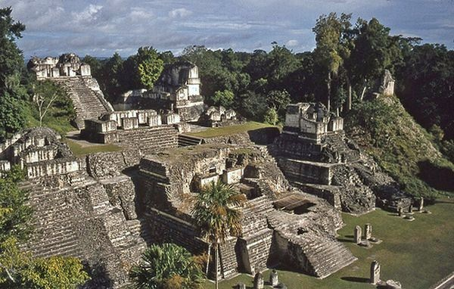
Classic Period
150 – 900 C.E.
Large complex cities created city-states
Cities laid out in a grid pattern
Mayan city-states gained control of the Yucatan Peninsula
Use of the Long Count Calendar

Slide 16
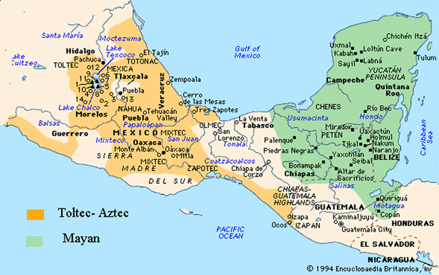
Post – Classic Period
900 – 1521 C.E.
By 900 C.E. drought and civil wars led to the decline of Mayan cities
Around 1200 C.E. the Aztecs were established in central Mexico
Established the capital at Tenochtitlan
The Aztec Empire was at its peak in 1519 C.E.

Slide 17
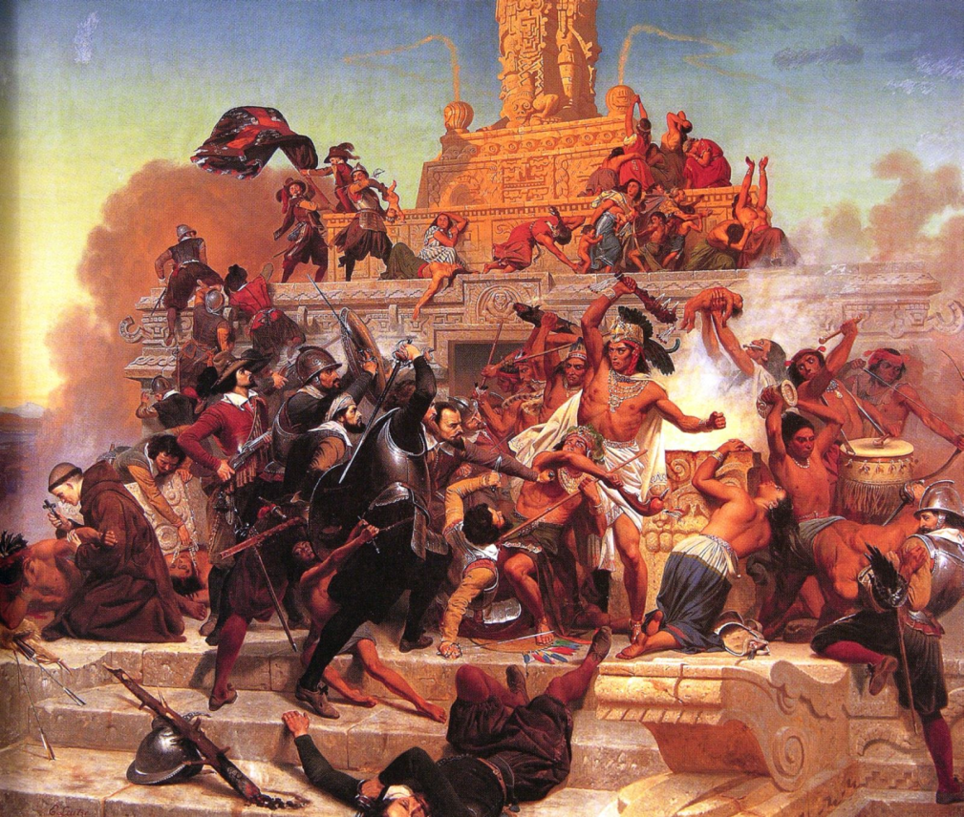
Arrival of the Spanish
1519 C.E.
Hernan Cortes and 500 troops land near Vera Cruz in July 1519
Welcomed by the Aztec chief, Montezuma – one year later he is killed
Spanish take control of Tenochtitlan in August 1521 ending the Aztec Empire

